Slide 1
Machine Learning CA1
Zygimantas Jakubauskas
Miroslava Slavikova

Slide 2
Slide Title
Make Effective Presentations
Using Awesome Backgrounds
Engage your Audience
Capture Audience Attention

Slide 3
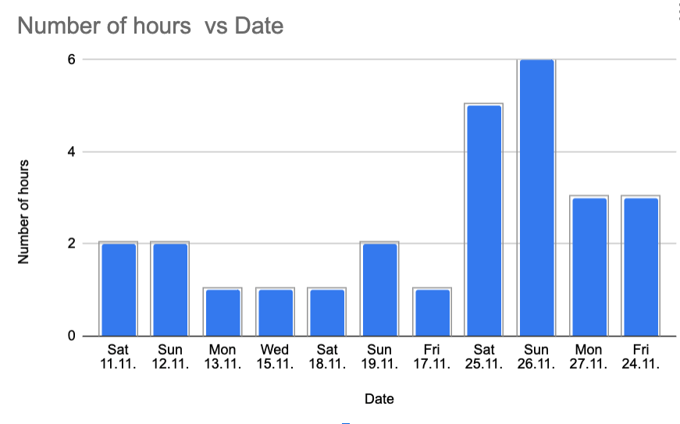
Time Spent on the Project

Slide 4
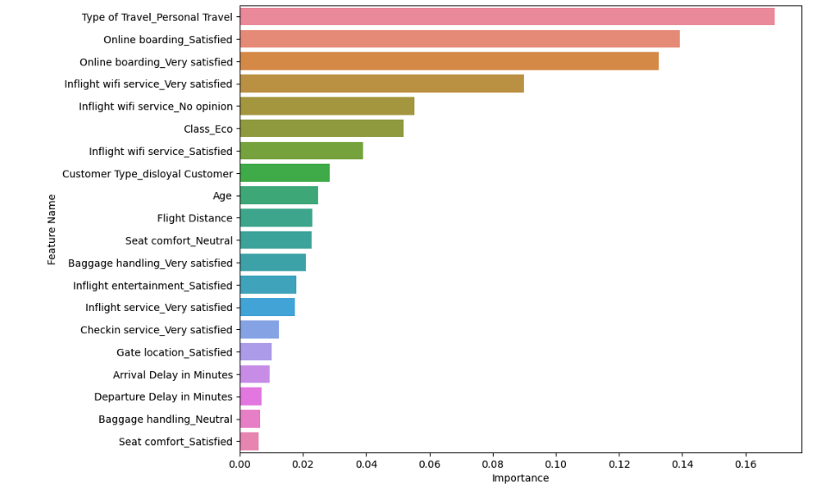
Bla bla

Slide 5
Slide Title
Product A
Product B
Feature 1
Feature 2
Feature 3
Feature 1
Feature 2
Feature 3

Slide 6
Thank you.

